Slide 1

IMPACT OF EMERGING TECHNOLOGY ON SOCIETY
Presented By :
Ankit Vinod Bari (62)
Yash Ravindra Kerkar (64)
Viraj Arvind Oza (66)
Kunal Rajendra Rajput (68)
Komal Purushottam Sapatale (69)
Rahul Rammilan Yadav (73)

Slide 2
Introduction
Emerging technologies are significantly shaping our daily lives, especially through social media, which connects people digitally.
While digital connections grow, they also raise concerns about data privacy and the spread of misinformation.
Technologies like Artificial Intelligence (AI), Automation, and Blockchain are widely used in industries, boosting productivity by handling repetitive tasks and analyzing large amounts of data.
These technologies can also lead to job losses, as machines perform tasks faster and more efficiently than humans.
Emerging technologies, such as telemedicine and wearable health devices, are making healthcare more accessible and convenient.
Online learning platforms and internet resources are providing greater access to education, allowing students to learn from anywhere. Virtual classrooms and interactive tools enhance collaboration.
As technologies like AI and robotics advance, they raise moral questions about decision-making, responsibility, and potential harm, outpacing the development of regulatory frameworks.
New technologies bring complex moral issues that need early reflection and regulation. AI and robotics pose challenges for the future of work, fairness, and human autonomy.

Slide 3
Societal Impacts and Ethical Considerations of Emerging Technologies
AI in Healthcare: AI has revolutionized healthcare by improving diagnostics, personalizing treatments, and optimizing operations. However, concerns around data privacy, security, and the potential over-reliance on AI remain. Solutions include stronger encryption for data protection, ensuring AI complements human professionals, and implementing cybersecurity measures.
Job Displacement: AI-driven automation enhances efficiency but raises concerns about job losses. To mitigate this, people must reskill and upskill in areas requiring creativity, critical thinking, and complex problem-solving. Educational institutions should focus on these areas to prepare future workers.
Blockchain: Blockchain's decentralized nature offers transparency but also poses challenges, such as the permanence of erroneous data and privacy concerns. Solutions include adding validation layers to fix errors and addressing the privacy risks associated with traceable transactions.
Nanotechnology: Nanotechnology, especially in military applications, presents both opportunities and risks. Its potential misuse can lead to the development of powerful weapons. Strict regulations and safety measures are necessary to prevent harm while benefiting from its innovations.
Impact of Emerging Technologies on Lifestyle: Technologies like AI and mobile devices influence lifestyle, leading to reduced physical activity, emotional strain, and excessive screen time. Solutions include tech-free periods to encourage social interaction and healthier lifestyles.

Slide 4
The Dual Impact of Emerging Technology
AI Technology:
Advantage: Enhances productivity and performs tasks faster and more efficiently.
Disadvantage: Could lead to job displacement, as AI can perform human tasks without breaks.
Internet of Things (IoT):
Advantage: Provides efficiency in daily life (e.g., smart home devices like Amazon Echo).
Disadvantage: Data privacy and security risks, potential misuse of large data by cybercriminals.
Augmented Reality (AR) and Virtual Reality (VR):
Advantage: Immersive experiences useful for education, training, and entertainment.
Disadvantage: High cost, potential eye strain, and concerns about reduced real-world interaction.
Biotechnology:
Advantage: Advances in medicine and agriculture, including genetic modification for better health.
Disadvantage: Ethical and safety concerns, especially around genetic modifications and privacy.

Slide 5
Quantum Computing:
Advantage: Can solve complex problems quickly, driving progress in areas like cryptography and material science.
Disadvantage: Expensive, complex, and potential threat to current encryption and security systems.
Smart Home Devices:
Advantage: Increased comfort, automation, and energy efficiency in homes.
Disadvantage: Privacy and security vulnerabilities, risk of hacking or system malfunctions.
Autonomous Vehicles:
Advantage: Reduces accidents, improves traffic, and enhances mobility for those unable to drive.
Disadvantage: Safety and ethical challenges, impacts on jobs, and need for new regulations.
Renewable Energy Technologies:
Advantage: Environmentally friendly, reduces reliance on fossil fuels, and supports sustainability.
Disadvantage: High setup costs and inconsistent supply, such as solar and wind depending on weather.
5G Technology
Advantage: Faster data speeds, supports innovations in smart cities, self-driving cars, and AR.
Disadvantage: Concerns over health risks and high infrastructure costs, especially in developing areas.

Slide 6
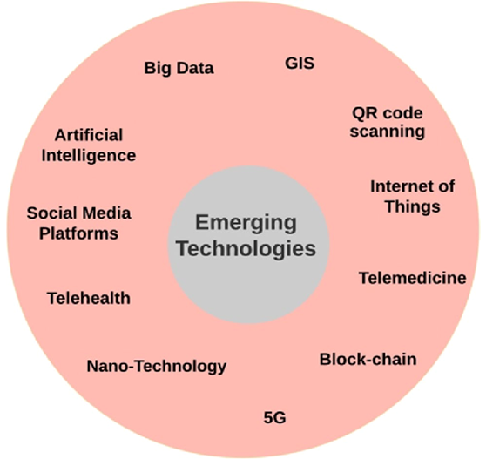
Key Emerging Technologies in Today's World
This diagram showcases key emerging technologies that are transforming various industries and sectors across the globe. Emerging technologies refer to innovative fields that are still evolving and have the potential to significantly impact society. The diagram highlights various technologies that are either new or are rapidly developing, and their influence on modern-day practices.
This diagram represents the interconnectedness and widespread applications of these emerging technologies, illustrating how they are shaping the future of industries such as healthcare, communication, finance, and information technology. The potential of these technologies will continue to grow as they evolve and adapt to new challenges and opportunities.

Slide 7
The Future of Emerging Technologies and Their Impact on Society
Emerging technologies are poised to significantly shape the future, much like the unpredictability of lottery numbers. They offer numerous benefits, particularly in manufacturing, where they enable the production of higher-quality products at lower costs and facilitate better maintenance through historical data analysis. In the medical field, new technologies enhance diagnostic accuracy and inform treatment decisions.
Workplace automation stands out as a key advantage, allowing for the efficient handling of repetitive tasks, thereby increasing human productivity. From a business perspective, integrating emerging technologies with intelligent automation enhances customer experiences, improves adaptability to market changes, and accelerates product introductions.
However, there are risks associated with these advancements, such as the potential for misuse or harmful programming of technologies. As machines increasingly mimic human behavior through machine learning and natural language processing, distinguishing between human and machine intelligence becomes challenging.
Overall, emerging technologies are revolutionizing various sectors, particularly manufacturing, finance, and healthcare, by optimizing processes, reducing waste, and effectively forecasting consumer demands. The impact of these technologies will continue to grow, reshaping industries and society as a whole.

Slide 8
Conclusion
Emerging technologies are significantly transforming our world, enhancing lives and increasing efficiency. However, with these advancements come responsibilities for developers, programmers, and designers to consider their positive and negative impacts on society. It is crucial to address issues such as data privacy, job displacement, and inequality to ensure that these technologies benefit everyone.
To mitigate negative consequences, robust policies must be established, focusing on ethical considerations, fairness, safety, and trust. Emerging technologies hold the potential to tackle global challenges, but they also pose risks, such as self-aware artificial intelligence and environmental concerns.
As these technologies integrate into daily life—evident in AI-equipped computers and voice-assisted smartphones—they require careful management to balance their benefits against drawbacks. Collaboration among governments, businesses, and individuals is essential to create protective policies that ensure data privacy and job security.
Ultimately, by understanding and addressing the societal impacts of emerging technologies, we can foster a fair and sustainable future for all.

Slide 9
Thank you

